Slide 1

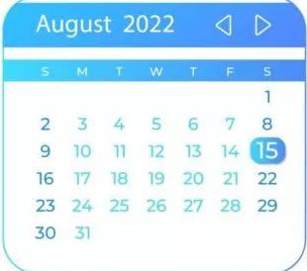



TrekPlan UI
[start]
Trek Plan
Departure Date:
Destination:
Propulsion Mode:
Selection Fields Only
(separate reservations are required for each traveler)
Rocket Name:

Slide 2
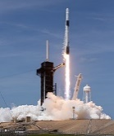
TrekPlan UI
[after selections]
Trek Plan
Departure Date:
August 15, 2022
Destination:
Mars
Propulsion Mode:
Conventional
Rocket Info Populates
Rocket Name:
Falcon 9
Company: SpaceX
Country: United States
Launch Cost: $67M
Weight: 1,210,000 lbs.
Thrust: 1,910,000 lb_{f}
W/T Ratio: 0.633507853
Velocity: 213,182 mph
Propellants:
Kerosene Rocket Propellant-1 (RP-1)
Liquid Oxygen (LOX)

Slide 3

Trek Plan
Destination: Mars
Departure Date: August 15, 2022
Arrival Date: September 2, 2022
Trek Duration: 457.8 hours (19 days)
Propulsion Mode: Conventional
Rocket Name: Falcon 9
Distance: 1.0500 astronomical units (au)
157,077,764 kilometers (km)
97,603,598 miles (mi)
TrekPlan UI
[after calculations]
Time and Distance Populates
Modify Trek Plan
Create Trek Reservation

